Slide 1
User guide to books at jstor
November 2014

Slide 2
Books at JSTOR is a program that offers ebooks from leading scholarly publishers, integrated with journals and primary sources on JSTOR’s easy-to-use platform.
As a nonprofit with a mission to serve the academic community, JSTOR worked closely with partner publishers, libraries, and scholars to develop this offering.
We focus on delivering great content and great experiences to researchers.
What is Books at jstor?

Slide 3
An integrated platform
The ebooks are integrated with other scholarly resources, including journal articles, book reviews, and primary sources, on JSTOR.org. You can cross-search the full text of all content you have access to through your library. Search results can be viewed across all content types, or filtered by type.
Related resources are connected on the platform. Book reviews and ebooks are cross-linked. Click on an author name to search for other works by that author across both books and journals.

Slide 4
A seamless user experience
Books at JSTOR’s unlimited-user model offers:
Simultaneous online access for an unlimited number of users
Unlimited DRM-free chapter downloads that never expire
Unlimited printing and copy/paste
No requirements to log in or use special software
The search results show ebook chapters, so you can navigate straight to the part of the book that’s most relevant to your search. It’s easy to read ebook chapters online or download chapter PDFs, without needing special software.
Researchers who already use JSTOR for journals will find that the ebooks work in a similar manner.

Slide 5
Searching on jstor.org
The basic search form appears on the main page of JSTOR…
and at the right-hand top of other pages within the site.

Slide 6
Basic search tips
Place words within quotation marks to search for exact phrases:
“to be or not to be”
“customer relationship management”
Use Boolean operators to construct a better search:
“tea trade” AND smuggling
microfinance OR microcredit
“united states” NOT “united kingdom”
Use field codes to search for titles and authors quickly:
To search for an article titles - ti:“Non-Cooperative Games”
To search for an author – au:“Albert Einstein”

Slide 7
Advanced search
JSTOR’s Advanced Search: http://www.jstor.org/action/showAdvancedSearch
Use the drop-down boxes to limit search terms to the title, author, abstract, or caption text
Use the “Narrow by” options to search only journals or only books, include/exclude book reviews, search for content published during a particular time frame, or search for content in a particular language
Focus your search in specific disciplines and titles using checkboxes

Slide 8
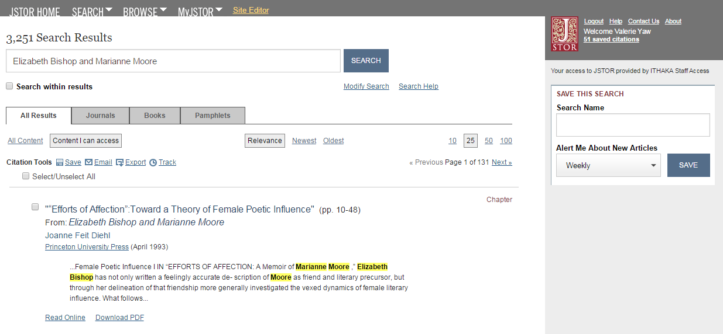
Search results
View results across all content types, or select “Books” to only see results from ebooks
The search results show book chapters, so you can quickly find the most relevant section of the book
Click the book’s title to visit the main page for that book
A text snippet shows the search term in context
You can read chapters online, or download chapter PDFs

Slide 9
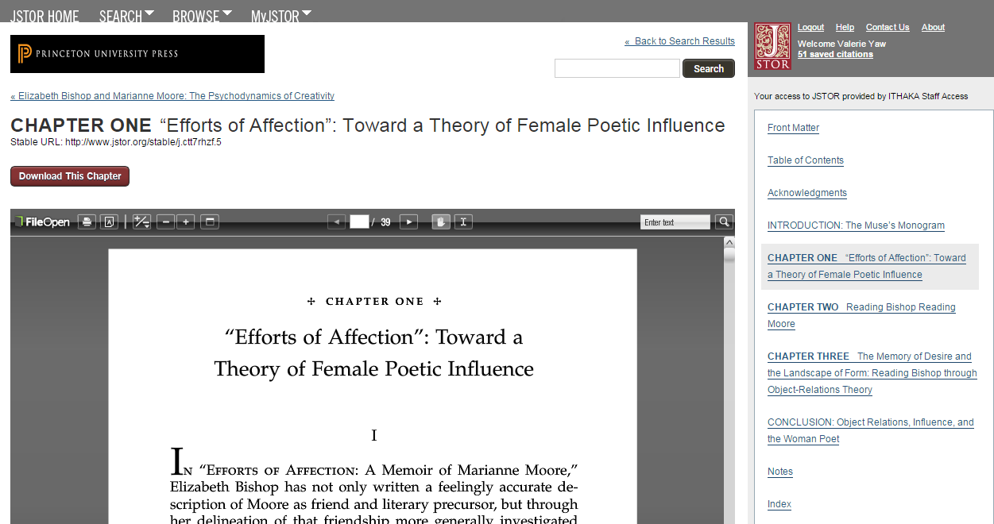
Chapter page
Navigate to the book’s main page
Navigate to another chapter using these links
Download the chapter PDF here
Use the online viewer to read or search within a chapter

Slide 10
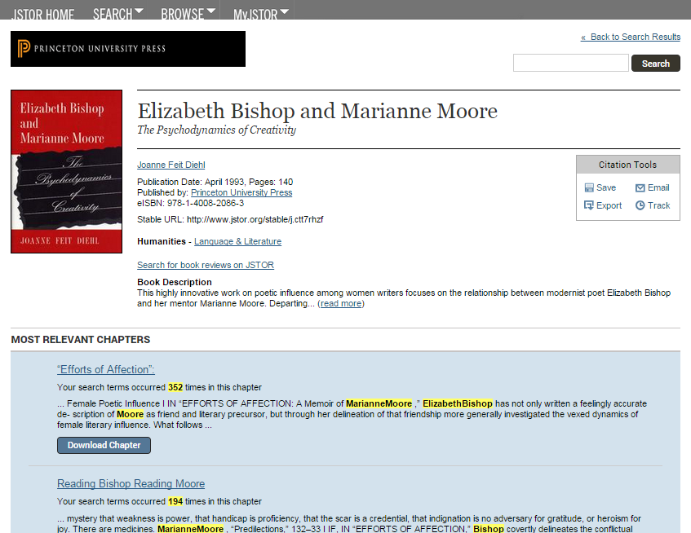
Table of contents page
Save, email, export, or track citations using a MyJSTOR account
Click the author’s name or “Search for book reviews on JSTOR” link to search for related content
When you reach this page through the search results, the two chapters most relevant to your search are highlighted
Below this, all the chapters are listed in order, along with a short excerpt for each chapter
You can view the chapters online, or download chapter PDFs

Slide 11
Organizing research with myJSTOR
MyJSTOR is a free tool that allows you to customize your experience and organize your research. Register at https://www.jstor.org/action/registration. Then, you can:
Save, email, and export citations
Save and automate searches
Set up email alerts for saved searches and tracked citations
You can also change your password and update your preferences at any time.

Slide 12
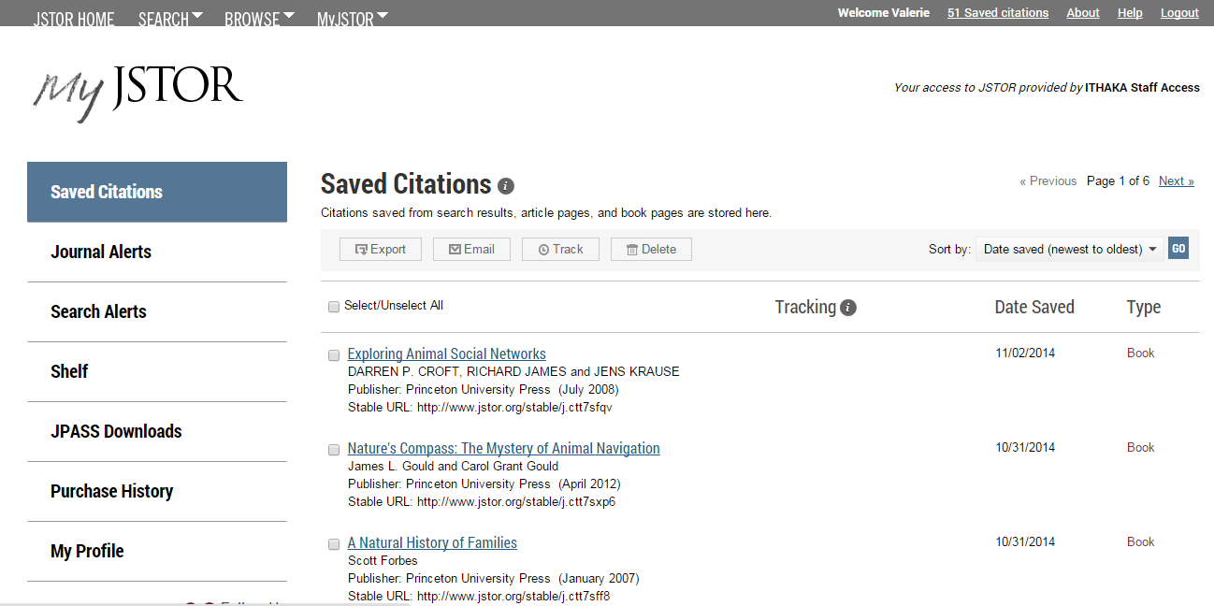
myjstor

Slide 13
Jstor is mobile-friendly
JSTOR uses responsive design to create a consistent and smooth experience across most mobile devices, as well as on laptops and desktops
Responsive design enables the JSTOR interface to adapt to the screen size of a device without requiring a separate mobile URL or any device configuration
Researchers can go directly to www.jstor.org on a smartphone or tablet and the JSTOR interface will adjust automatically

Slide 14
Off-campus access
JSTOR’s “Institution Finder” allows researchers using JSTOR from a remote location to log in to their library proxy server from the JSTOR site
Users locate their institution from a list on the JSTOR website, log in to their library website, and are returned to the page they started on at JSTOR
Visit https://www.jstor.org/action/showLogin to use the Institution Finder, located on the right side of the page

Slide 15
Please contact JSTOR’s User Services team if you need assistance:
Email: support@jstor.org
Twitter: @JSTORsupport
Website: http://about.jstor.org/jstor-help-support
Thank you!

